Slide 1
Work Station Assessments
Health & Safety

Slide 2
Work Station Assessment
It is the responsibility of all Cerner associates to ensure they work in a safe environment.
It is important to set up your workstation properly so you can be as comfortable as possible and to help avoid any potential health problems.
You should make full use of all the adjustment facilities within your workstation to ensure that it is best suited to you as an individual.
The following guidance aims to provide helpful information to ensure you are working as comfortably as possible and to assist you with your self assessment.
ACTION: Please read the following guideline & advice before completing the self assessment survey.

Slide 3
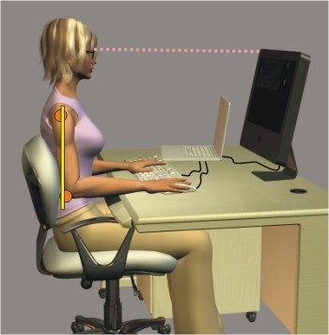
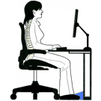
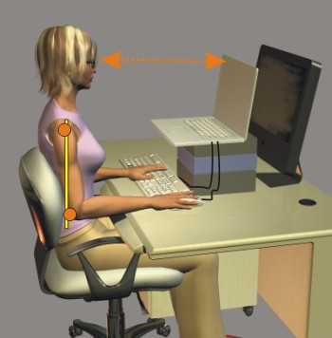
Posture
Optimal Seating Position
Head: Centred over shoulders and an arm’s length from the monitor; top of screen should be horizontal or just below eye level.
Chair: Slanted slightly forward; the edge should end 3 fingers from the back of your knees.
Neck: Held upright, without strain. Chin is tucked in.
Shoulders: Held down and backwards; being relaxed and similar to that during resting.
Back: Sit upright with good support at the upper and lower back to maintain the S-shaped curve of your back.
Elbows: Maintained relaxed and close to the body, and 90°to the working surface.
Wrists: Relaxed and held neutral over the keyboard, without resting on the work surface.
Lower Limbs: Hips are 90º to the body and knees slightly lower than the hips with feet flat on the floor or on a support.

Slide 4
Overview of Good Posture

Slide 5
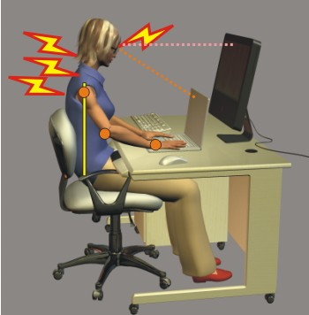
Posture continued…..
Bad Posture
The screen is too low, pulling your head down.
The keyboard is too far away, pulling the elbows forward and up.
The screen is too close, making your eyes work harder to focus on it.
Thus, overuse injuries may occur in the eyes, neck, shoulders and back.
The high elbow position may also lead to wrist problems.

Slide 6
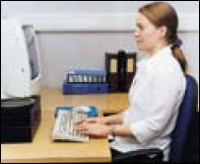
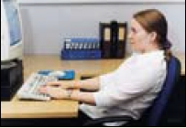
Chair
Chair Adjustment
You should be able to carry out your work sitting comfortably.
You should have a straight back, supported by the chair, with relaxed shoulders.
Adjust the chair height to get your arms in the right position, then adjust the VDU height, if necessary.
The chair backrest should be tightened so that it does not give way with body weight.
Adjust the backrest of the chair so that it supports the curve in lower back.
Hips should be as far back in the chair as possible.
Instructions of chair adjustments can be found under seat on left hand side.
Examples are to the left of good & bad seating positions.

Slide 7
Monitor (Display Screen)
This information is only for people with separate monitors, though if you use a screen that is built into your device some of the information provided can be useful.
The monitor/screen should be placed directly in front of you at arms length
The top of screen should be at eye level or slightly lower
Make sure the screen is clean
Adjust the text size to avoid eye strain
Screen should be free from glare & reflections
Notes:
Consider another picture

Slide 8
Keyboard
This information is only for people with separate keyboards, though if you use a keyboard that is built into your device some of the information can be useful
If your keyboard has a tilt facility adjust so is comfortable for you
Make sure there is enough desk space to support your hands & wrists
You may find a wrist rest beneficial
Avoid bending hands at wrists, hitting keyboard to hard, and over stretching fingers
Keep your hands & wrist in line with your forearm in a straight neutral position
Keep your keyboard clean & replace if any characters are missing or cannot be read

Slide 9
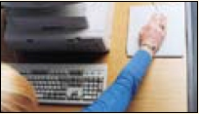
Mouse
Most devices are best placed as close as possible to your device or keyboard
Avoid overreaching
Do not leave your hand on the mouse when you are not using
Do not hold the mouse to tight
Keep arm relaxed and wrist straight
Movement of the mouse should come form the whole arm & shoulder not just the wrist
Make sure your wrist & forearm is supported, either by the desk, arm of chair or wrist support
Keep desk surface clear & mouse in full working order

Slide 10
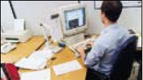
Work space environment
Rearrange equipment, papers etc to bring frequently used things within easy reach.
Consider working in a less cluttered work space to create more work surface.

Slide 11
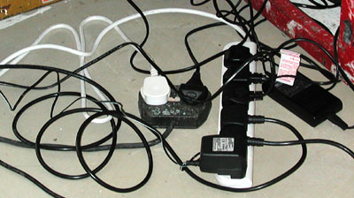
Environment
You should work in a well lit environment. Lighting should not be too light or too dim, consider adjusting office blinds
Cables should be tidy & not a trip or snag hazard

Slide 12
Further Assistance
For further Assistance please contact Paul Wood, Security Specialist & Health & Safety advisor.
Now please return to CLM to complete your Workstation Self Assessment

